Slide 1
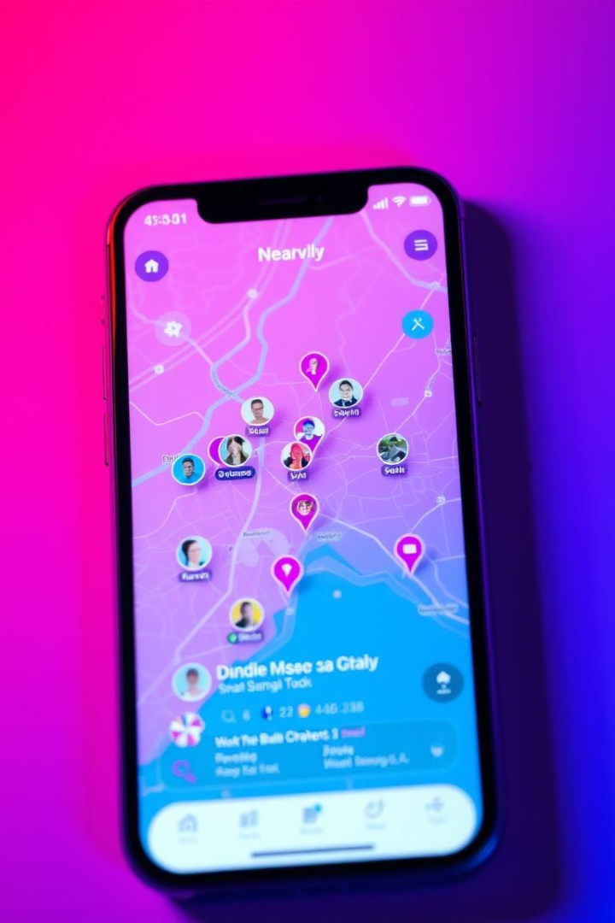
BrewNet: Geo-Location Connection App
Building meaningful, localized social connections.
by The Coders:
Ankit Kumar Singha
Tejraj Sahu
Nishant Ranjan Rout
Dambarudhara Rout

Slide 2
Background & Problem Statement
Digital Overload
Networking Struggles
Gaps in Solutions
60% adults feel lonely despite social media (_Pew Research, 2024_).
78% professionals struggle to find local networking (_LinkedIn Survey, 2023_).
Lacks real-time proximity, consent-first approach, smart interest-matching.

Slide 3

Market Opportunity & Demand
4.9B
67%
Global Users
Local Networking
Social App Users (2024) Statista
Millennials & Gen Z McKinsey Report
12%
Location-Based App
CAGR (2023–2030) Grand View Research

Slide 4
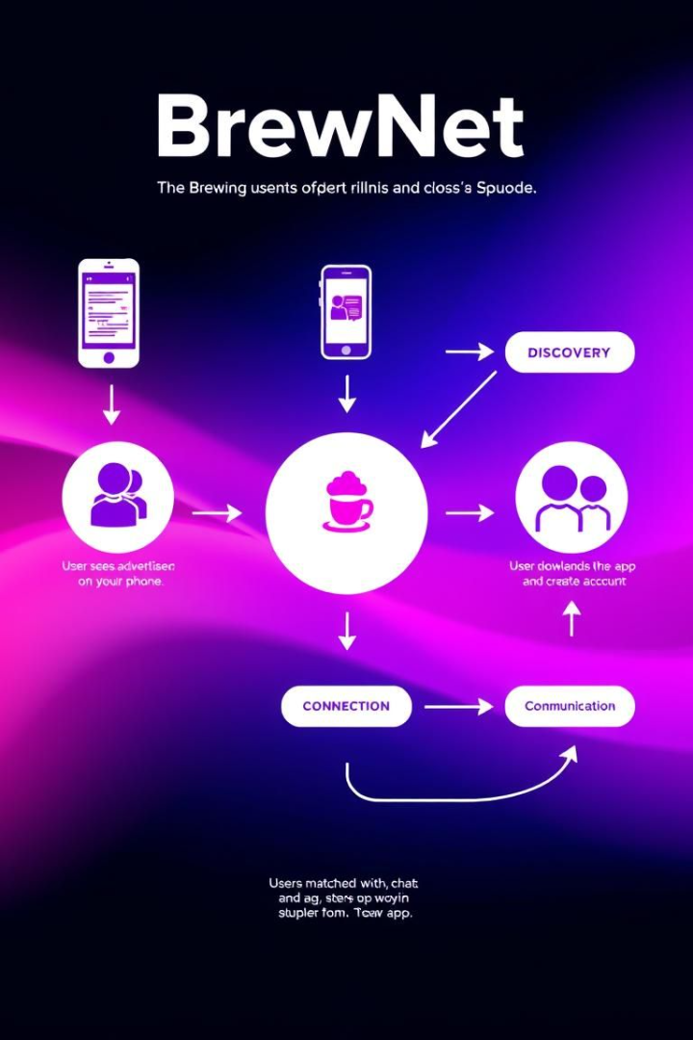




How BrewNet Works
Real-Time Geo-Location
Customizable radius.
Interest-Based Matchmaking
AI-powered suggestions.
Consent-Driven Connections
Request first, chat after.
Privacy Controls
Toggle visibility.

Slide 5




Three Ways ML Enhances Connections
Smart Matches
Hotspot Finder
NLP & collaborative filtering ensures relevant suggestions.
DBSCAN clustering reveals popular hangout spots.
Safety Shield
CNN & sentiment analysis auto-blocks fake profiles.

Slide 6
Core ML Features: Interactive Comparison
Smart Matches
Hotspot Finder
Safety Shield
NLP + Collaborative Filtering
DBSCAN Clustering
CNN + Sentiment Analysis
Suggestions that fit you.
See where people like you hangout.
Auto-block fakes & creeps

Slide 7
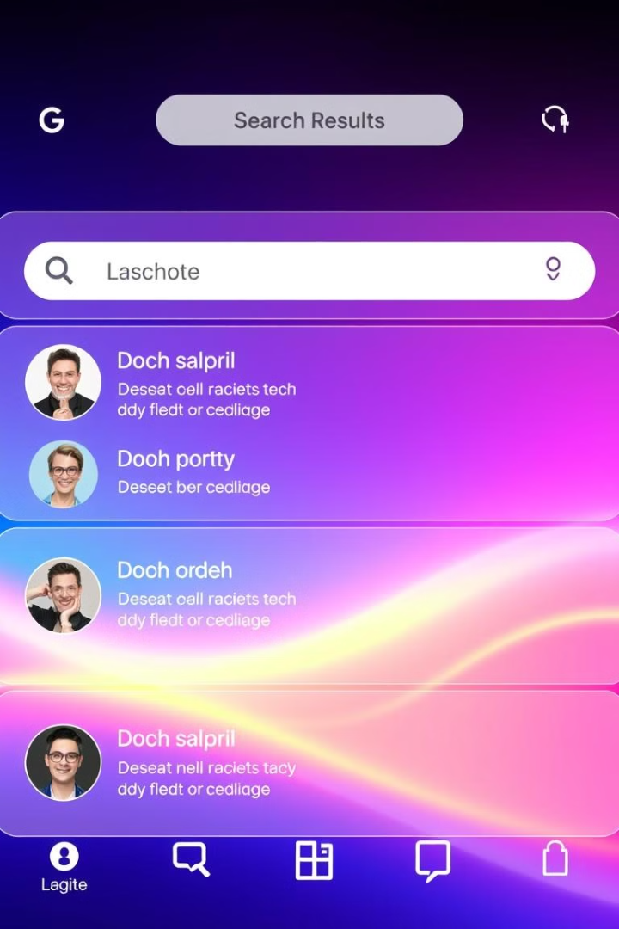

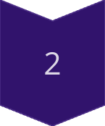
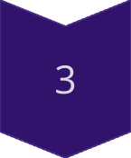
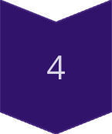
Live Demo Simulator: Find Your Niche
Enter Hobby
Type a hobby (e.g., 'yoga').
Match Found
See matches nearby.
Discover Hotspot
Find popular locations
Adjust Privacy
ML optimizes settings.

Slide 8
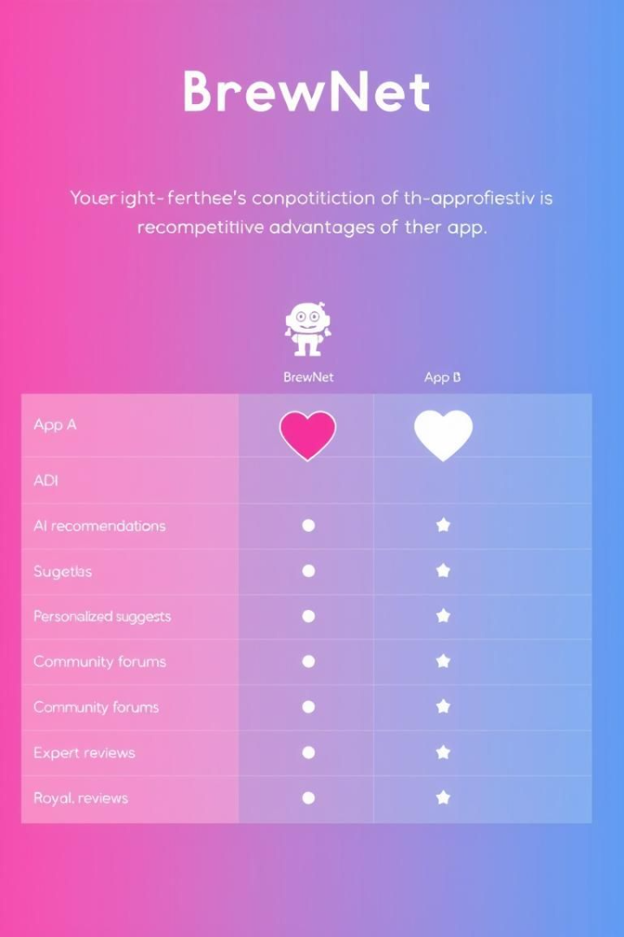
Competitive Edge
Feature
BrewNet
Meetup
Bumble BFF
Real-Time Proximity
✅
❌
❌
Interest-Based AI
✅
❌
⚠️ (Basic)
Consent-First Model
✅
❌
❌
Privacy Controls
✅
⚠️
⚠️

Slide 9

Future Roadmap: Expanding AI Capabilities
1
2025
Basic matching.
2
2026
Proactive meetup suggestions.
3
2027
Predictive no-show warnings.

Slide 10

Shape BrewNet's AI Future
Key takeaways and next steps for investors:
Join Beta
Shape BrewNet's AI.
Contact Us
Partner for growth.

Slide 11
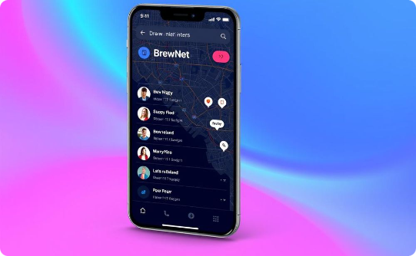
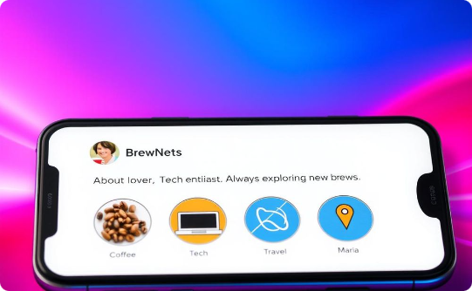
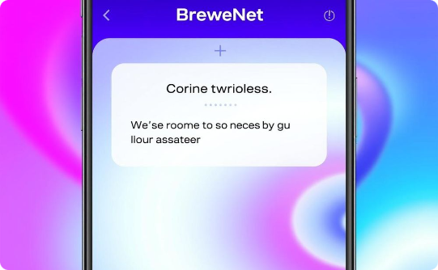
Prototype Demo (MVP)
Map View
Profile Preview
Connection Request
Nearby users with interest tags.
Bio, interests, mutual connections.
Customizable message.

Slide 12



Business Model & Monetization
Premium
$4.99/month, larger radius, advanced filters.
Freemium Model
Local Partnerships
Basic features free.
Promoted events.
2
1
3

Slide 13
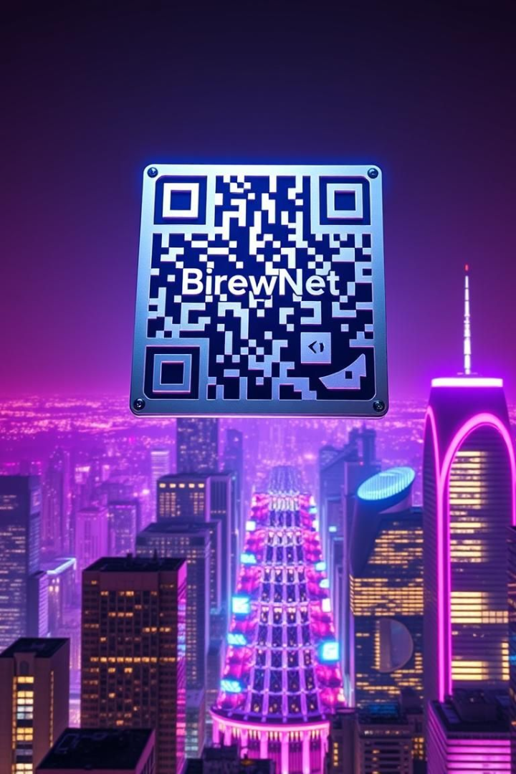
Conclusion & Call to Action
Untapped Market
Consent-based, hyper-local networking.
Scalable Solution
Adaptable for professional, dating, hobbyist.
CTA: Let’s build connections that matter—one location at a time. Join our beta today!

